Slide 1

Credits earned on completion of this course will be reported to AIA CES for AIA members. Certificates of Completion for both AIA members and non-AIA members are available upon request.
This course is registered with AIA CES for continuing professional education. As such, it does not include content that may be deemed or construed to be an approval or endorsement by the AIA of any material of construction or any method or manner of handling, using, distributing, or dealing in any material or product.
_______________________________________Questions related to specific materials, methods, and services will be addressed at the conclusion of this presentation.

Slide 2
Mock Bid Simulation Workshop
Mark Pitts CPE – Haley’s Hope Enterprises
Jacob Dyer – Gulf Seaboard General Contractors, Inc.
Don Wood CPE – Quantum Consulting
Ron Semel AIA CPE – BCOM

Slide 3


American Society of Professional Estimators
ArchEx
November 5, 2014
Richmond, VA
AIA Provider
Mock Bid Simulation Workshop
Course Number: W-07

Slide 4
Estimating Overview
A General Overview of the Construction Estimating Profession

Slide 5

Estimating Environment Topics
Ron Semel
Estimating Profession as an Overview
Jacob Dyer
Estimating from the General Contractor Point of View
Don Wood
Estimating from the Subcontractor Point of View
Mark Pitts
Ethics in Estimating

Slide 6
Estimating Profession as an Overview
Types of Estimates
Hard Bid (Loser Wins)
CM (no surprise where the price will land)

Slide 7
Estimating Profession as an Overview
What it’s like to be an estimator
Companies live and die by your numbers
Bid Day is Crazy
Know the costs for:
Materials
Labor
Schedules
Phasing
Know what your company is capable of

Slide 8
Estimating Profession as an Overview
Software will never do the job of an estimator
Design Guidance
Problem Solving
It’s all about relationships

Slide 9
Estimating Profession as an Overview
Why Architects need to be estimators too
VE protection
Pay-app & change order review
Keep your client from being taken to the cleaners
ie: front loading
6th sense (three corner corners)

Slide 10
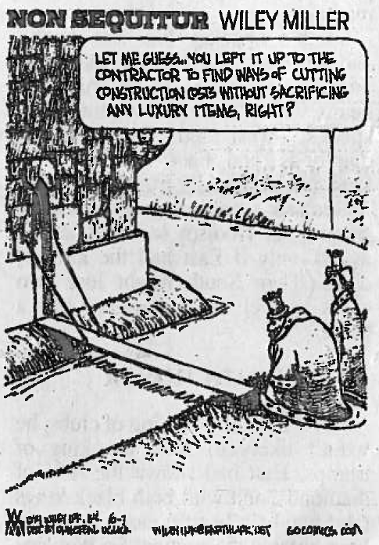

Slide 11
Estimating from the General Contractor Point of View
Estimating as a General Contractor
Estimating – “Educated Guess”
Responsibility & Risk
Multiple pieces & parts

Slide 12
Estimating from the General Contractor Point of View
Project Review
Project Invitation to Bid
Review the Bid Documents – “Plans & Specifications”
Clarification if necessary

Slide 13
Estimating from the General Contractor Point of View
Coverage
List of ALL line items for the project
Solicitation
Scope check

Slide 14
Estimating from the General Contractor Point of View
Takeoff
Self-performed work
Scopes of work not typically picked up
Potential for No Coverage

Slide 15
Estimating from the General Contractor Point of View
Package
Takeoff with pricing
General Conditions with pricing
Summary of Estimates
Preliminary Schedule

Slide 16
Estimating from the General Contractor Point of View
Bid Day
Be Prepared
Sub Pricing – Even at the Last Minute
Don’t Double / Don’t Miss
Call it in – How complex is the bid form?

Slide 17
Estimating from the General Contractor Point of View
Review
How did you do against your competition?
Did you leave anything on the table?
Could you have done the project differently to be more efficient, less time, less costly?
Did you get all of your pricing in on time?
You won the project!!
Double check and then Triple check

Slide 18


Slide 19


Slide 20
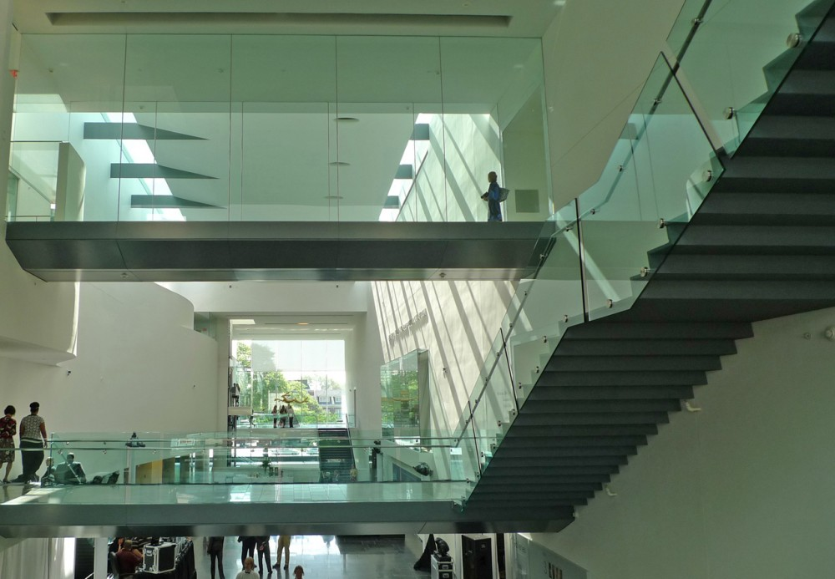

Slide 21
Estimating from the Subcontractor Point of View
Document Review
Complete set
Pre-bid check list
Scope of Work/Price Sheet development
Lead Estimator Role

Slide 22
Estimating from the Subcontractor Point of View
Scope Review
Critical element
Different Scopes for Different GC’s – same project
Communicate

Slide 23
Estimating from the Subcontractor Point of View
Specialty Items
Immediate notification
Continue flow chain of information – All tiers
Complete conformance

Slide 24
Estimating from the Subcontractor Point of View
Bid Day Pitfalls
Late pricing
Unsolicited pricing
Subject to approval pricing
Last minute schedule/construction modifications
Last minute addenda

Slide 25


Slide 26


Slide 27
Ethics in Estimating
ETHICS are the rules and standards governing the conduct of a person or the conduct of the members of a profession … distinguishing between good and evil … between right and wrong … and between virtuous and nonvirtuous characteristics and conduct.

Slide 28
Ethics in Estimating
Fairness, Honesty, and Integrity.

Slide 29
Ethics in Estimating
Project Specific Principles
Bid Shopping
Bid Peddling
Collusion
Accurate Estimating

Slide 30
Ethics in Estimating
Professional Behaviors
Know your limits of estimating
Continued Education
Promote relationships within profession
Maintain confidence in the information you receive
Obey the Law
Do not compromise your judgment as an estimator

Slide 31


Slide 32


Slide 33
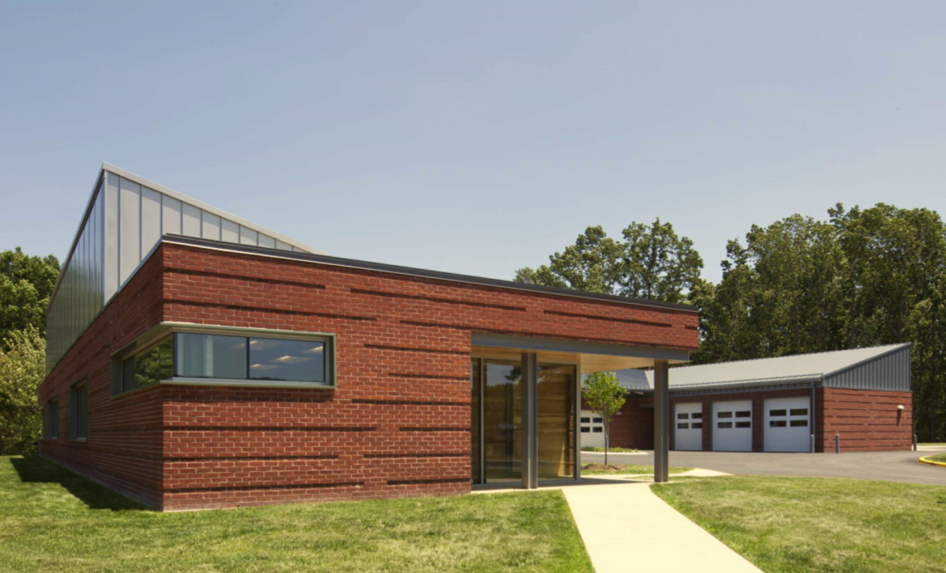

Slide 34
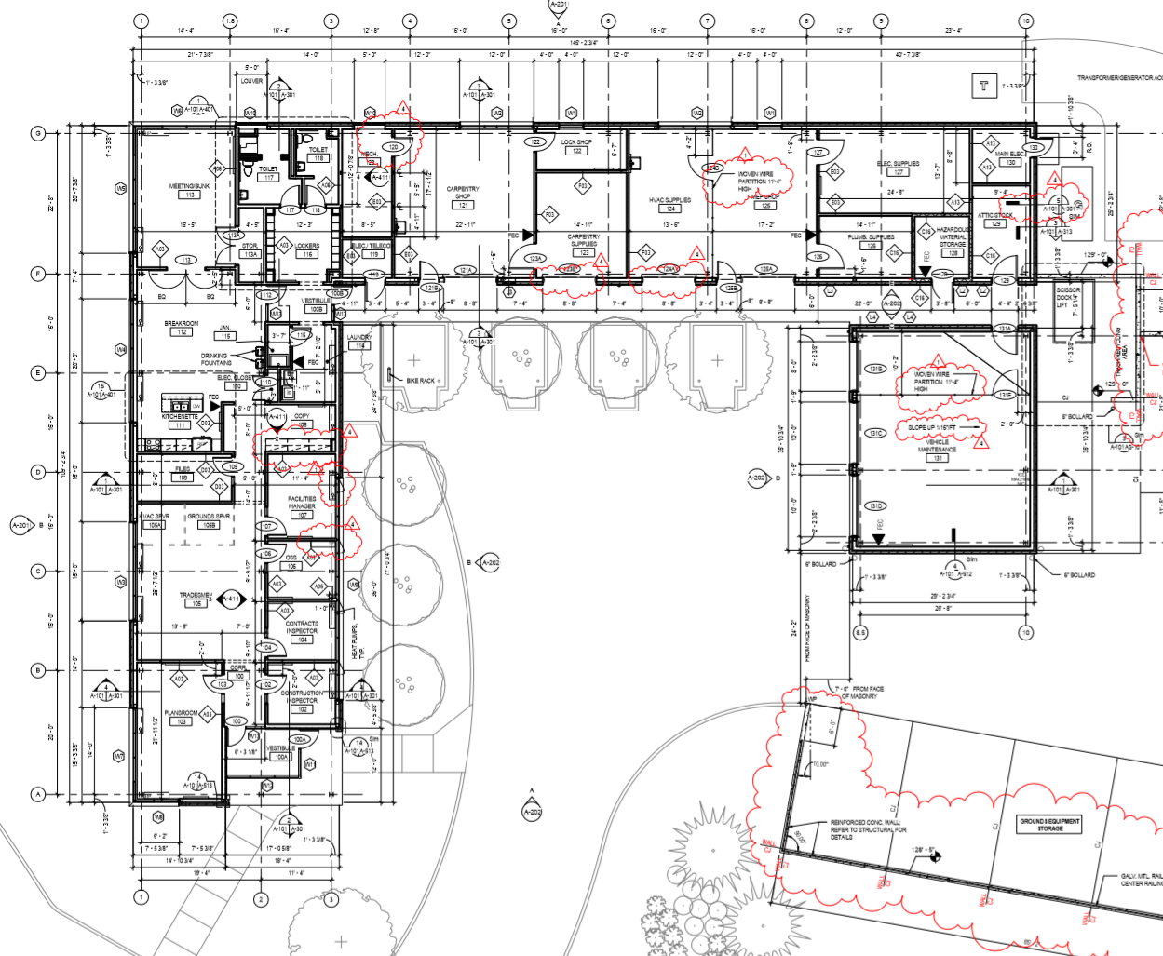

Slide 35
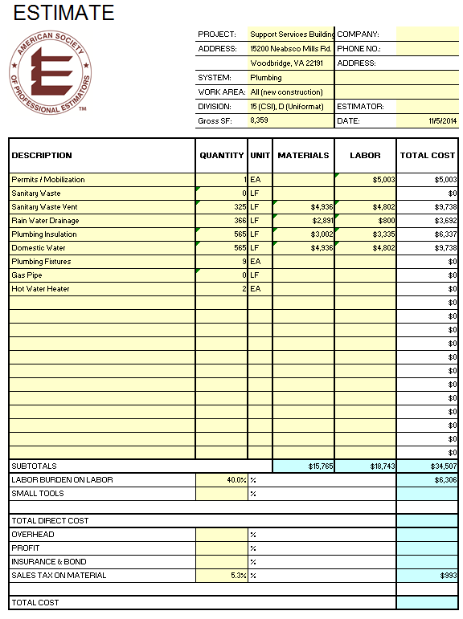

Slide 36
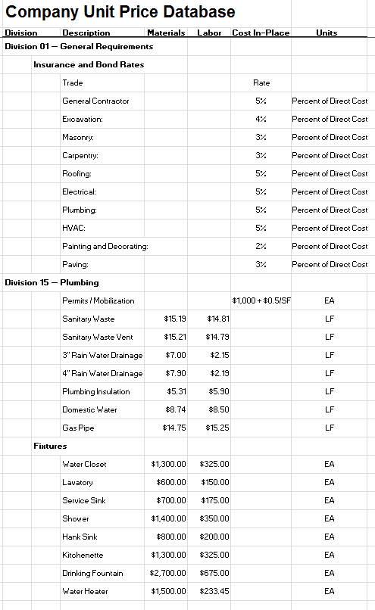

Slide 37
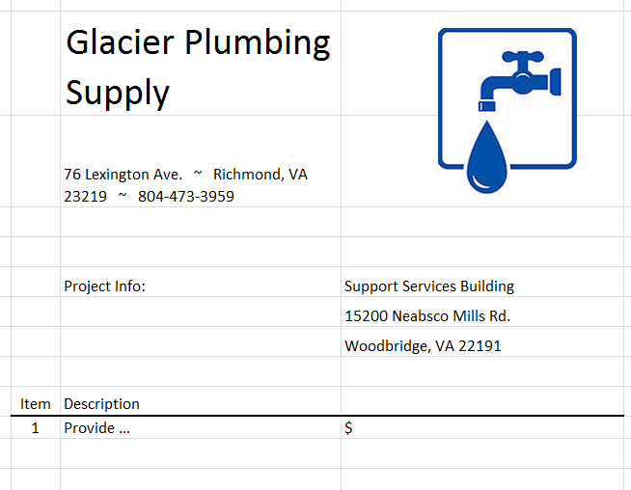

Slide 38

Let’s Estimate!!!

Slide 39
Bid Analysis
Bid Opening
Organizer Comments
Q&A

Slide 40


Slide 41
Thank You
from the
American Society of Professional Estimators
(ASPE)
Richmond Chapter #82
www.aspe-richmond.org

